Slide 1





Module 02 – Working with environment
WWW.SELACLOUD.COM

Slide 2

Agenda
Introduction
sys module
Command-line arguments
Standard data streams
Redirections
Exiting the program os module
Environment variables
Working with directories

Slide 3
Introduction
Working with the environment in Python refers to managing and manipulating the runtime environment in which a Python program executes.
The environment includes various system-level variables, configurations, and resources that affect the behavior of the program.
Python provides a module called os (Operating System) that allows developers to interact with the environment. It offers functions and methods to access and modify environment variables, work with files and directories, handle processes, and perform other system-related operations.
Notes:
Python is dynamically-typed and garbage-collected. It supports multiple programming paradigms, including structured (particularly, procedural), object-oriented and functional programming.
It was built to be as readable as possible, and is significant indentation driven (Off-side rule).
The language's core philosophy is summarized in the document The Zen of Python (PEP 20), which includes aphorisms such as:
Beautiful is better than ugly.
Explicit is better than implicit.
Simple is better than complex.
Complex is better than complicated.
Readability counts.
For further reading:
Python (programming language) - Wikipedia

Slide 4
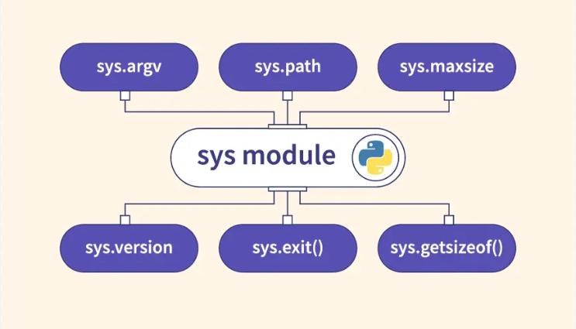
sys module
This module provides a number of functions and variables that can be used to manipulate different parts of the Python runtime environment.
This module provides:
— access to some variables used or maintained by the interpreter,
— access to functions that interact with the interpreter
Notes:
Python is dynamically-typed and garbage-collected. It supports multiple programming paradigms, including structured (particularly, procedural), object-oriented and functional programming.
It was built to be as readable as possible, and is significant indentation driven (Off-side rule).
The language's core philosophy is summarized in the document The Zen of Python (PEP 20), which includes aphorisms such as:
Beautiful is better than ugly.
Explicit is better than implicit.
Simple is better than complex.
Complex is better than complicated.
Readability counts.
For further reading:
Python (programming language) - Wikipedia

Slide 5
sys module — version and platform
sys.version
— The output: 3.4.3 (v3.4.3:9b73f1c3e601, Feb 24 2015, 22:43:06) [MSC v.1600 32 bit (Intel)]
sys.platform
System platform value
Linux (2.x and 3.x) linux2
Windows win32
Windows/Cygwin cygwin
etc
Notes:
Python is dynamically-typed and garbage-collected. It supports multiple programming paradigms, including structured (particularly, procedural), object-oriented and functional programming.
It was built to be as readable as possible, and is significant indentation driven (Off-side rule).
The language's core philosophy is summarized in the document The Zen of Python (PEP 20), which includes aphorisms such as:
Beautiful is better than ugly.
Explicit is better than implicit.
Simple is better than complex.
Complex is better than complicated.
Readability counts.
For further reading:
Python (programming language) - Wikipedia

Slide 6
Command-line arguments
Arguments passed to a script called Command Line Arguments
Python script can access those command line arguments through sys.argv list.
The first item of this list is a path of the script itself
import sys for i, arg in enumerate(sys.argv): if i == 0: print("Script name: {}".format(sys.argv[0])) else: print("{}. argument is: {}".format(i, sys.argv[i]))

Slide 7
Standard data streams
Almost every programmer familiar with standard streams:
— standard input - as default, connected to the keyboard
— standard output - as default, connected to the terminal (or working window)
— standard error - as default, connected to the terminal (or working window)
These data streams can be accessed from Python via.the objects — of the sys module: sys.stdin, sys.stdout and sys.stderr.

Slide 8
Standard data streams

Slide 9
Standard data streams — cont’d
import sys
sys.stdout.write("some string") s="some string" sys.stdout.write(s) line = sys.stdin.readline()[:-1] #removes the \n from the end of the line sys.stdout.write(line)
Notes:
PyCharm is currently one of the most used IDE for python development, It provides code analysis, a graphical debugger, an integrated unit tester, integration with version control systems (VCSes), and supports web development with Django as well as data science with Anaconda.
It was created by JetBrains
It is mostly popular because of many things, such as:
It is considered as an intelligent code editor, fast and safe refactoring, and smart code.
Features for debugging, profiling, remote development, testing the code, auto code completion, quick fixing, error detection and tools of the database.
Support for Popular web technologies, web frameworks, scientific libraries and version control.

Slide 10
Redirections
The standard output, error and input can be redirected e.g. into a file, so that we can process this file later with another program.
We can redirect both stderr and stdout into the same file or into separate files
Notes:
PyCharm is currently one of the most used IDE for python development, It provides code analysis, a graphical debugger, an integrated unit tester, integration with version control systems (VCSes), and supports web development with Django as well as data science with Anaconda.
It was created by JetBrains
It is mostly popular because of many things, such as:
It is considered as an intelligent code editor, fast and safe refactoring, and smart code.
Features for debugging, profiling, remote development, testing the code, auto code completion, quick fixing, error detection and tools of the database.
Support for Popular web technologies, web frameworks, scientific libraries and version control.

Slide 11
Console Methods

Slide 12
Redirections — cont’d
import sys fd = open("in", "r") sys.stdin = fd x = input() #reads from the file print(x)
import sys
save_stdout = sys.stdout fd = open("test.txt","w") sys.stdout = fd print("This line goes to test.txt")
#... Do things...
sys.stdout = save_stdout fd.close() # return to default:
Notes:
PyCharm is currently one of the most used IDE for python development, It provides code analysis, a graphical debugger, an integrated unit tester, integration with version control systems (VCSes), and supports web development with Django as well as data science with Anaconda.
It was created by JetBrains
It is mostly popular because of many things, such as:
It is considered as an intelligent code editor, fast and safe refactoring, and smart code.
Features for debugging, profiling, remote development, testing the code, auto code completion, quick fixing, error detection and tools of the database.
Support for Popular web technologies, web frameworks, scientific libraries and version control.

Slide 13
os module
The OS module provides a portable way of using operating system dependent functionality.
The functions that the OS module provides allows you to interface with the underlying operating system that Python is running on — be that Windows, Mac or Linux.
Notes:
PyCharm is currently one of the most used IDE for python development, It provides code analysis, a graphical debugger, an integrated unit tester, integration with version control systems (VCSes), and supports web development with Django as well as data science with Anaconda.
It was created by JetBrains
It is mostly popular because of many things, such as:
It is considered as an intelligent code editor, fast and safe refactoring, and smart code.
Features for debugging, profiling, remote development, testing the code, auto code completion, quick fixing, error detection and tools of the database.
Support for Popular web technologies, web frameworks, scientific libraries and version control.

Slide 14
Lab 01

Slide 15
Environment variables
os.environ - A mapping object representing the string environment.
os.getenv(varname, value=None) - Return the value of the environment variable varname if it exists, or value otherwise.
For example:
os.environ['HOME’]
os.getenv("HOME")
Both returns a PATH environment variable value.
PATH value specifies the directories in which executable programs ‘are " located on the machine that can be started without knowing and typing the whole path to the file on the command line
Notes:
PyCharm is currently one of the most used IDE for python development, It provides code analysis, a graphical debugger, an integrated unit tester, integration with version control systems (VCSes), and supports web development with Django as well as data science with Anaconda.
It was created by JetBrains
It is mostly popular because of many things, such as:
It is considered as an intelligent code editor, fast and safe refactoring, and smart code.
Features for debugging, profiling, remote development, testing the code, auto code completion, quick fixing, error detection and tools of the database.
Support for Popular web technologies, web frameworks, scientific libraries and version control.

Slide 16
Environment variables — cont’d
os.putenv(varname, value) - Set the environment variable named varname with a value.
— Such a changes to the environment affects the sub- processes, created after the change
Notes:
PyCharm is currently one of the most used IDE for python development, It provides code analysis, a graphical debugger, an integrated unit tester, integration with version control systems (VCSes), and supports web development with Django as well as data science with Anaconda.
It was created by JetBrains
It is mostly popular because of many things, such as:
It is considered as an intelligent code editor, fast and safe refactoring, and smart code.
Features for debugging, profiling, remote development, testing the code, auto code completion, quick fixing, error detection and tools of the database.
Support for Popular web technologies, web frameworks, scientific libraries and version control.

Slide 17
os.path — Common pathname manipulations
os.path.dirname(path) - return the directory name of pathname path
os.path.exists(path) - return True if path refers to an existing path
os.path.isfile(path) - return True if path is an existing regular file.
os.path.isdir(path) - return True if path is an existing directory.
os.path.islink(path) - return True if path refers to a directory entry that is a symbolic link
os.path.join(path, *paths) - join one or more path components intelligently
etc
Notes:
PyCharm is currently one of the most used IDE for python development, It provides code analysis, a graphical debugger, an integrated unit tester, integration with version control systems (VCSes), and supports web development with Django as well as data science with Anaconda.
It was created by JetBrains
It is mostly popular because of many things, such as:
It is considered as an intelligent code editor, fast and safe refactoring, and smart code.
Features for debugging, profiling, remote development, testing the code, auto code completion, quick fixing, error detection and tools of the database.
Support for Popular web technologies, web frameworks, scientific libraries and version control.

Slide 18
Working with directories
os.getcwd()— returns current working directory
os.chdir(path)— change current directory
Create a directory named path os.mkdir(path)
Recursive directory creation function. os.makedirs(path)
Return a list of the entries in the directory given by path. os.listdir(path)
Remove (delete) the file path. os.remove(path)
Remove (delete) the directory path. os.rmdir(path)

Slide 19
Lab 02

